Slide 1
Real-time Transport Protocol
Matt Boutell
CS457: Computer Networks
November 15, 2001

Slide 2

Fast-forward to the Year 2021
Director of Development for MME, Inc.
You
Common Service
Video
Conferencing
Streaming
Audio
Movies
?

Slide 3
Two Goals of RTP’s Common Service
General enough to be truly “common”
  Who knows what applications are coming?
  Throughout history, communication has changed:
    Oral (traditions passed between generations)
    Written
    Visual
Specific enough to actually be useful

Slide 4
Outline of Talk
Multimedia applications’ requirements
RTP architecture
RTP details
Vic: an application using RTP
Summary: RTP does meet the requirements

Slide 5
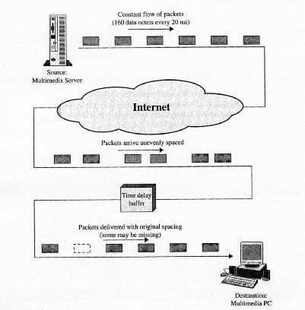

Slide 6
Requirements (1)
Timing
  Time-stamping for buffered playback
    to minimize jitter
  Synchronization of multiple streams
  Dynamic frame boundaries
    Video: frame length varies due to compression
    Audio: “talkspurts”

Slide 7
Requirements (2)
Network issues
  Dealing with packet loss
  Dealing with congestion
    Even with multicast
  Bandwidth utilization
    Minimize header bits

Slide 8
Requirements (3)
Miscellaneous
  Interoperability
    Encoding
    Compression
  ID of source
    To whom am I listening?
    Useful especially in video-conferencing

Slide 9
Requirements Summary
This is not TCP!
  Who cares if we lose a packet or two?
    (Not us!)
  Who cares if we have jitter?
    (We do!)
Calls for a different protocol...

Slide 10

RTP Architecture
“ALF” and “ILP”
Application-level framing:
  The application best knows its own needs
  May not ask for retransmission, but for lower resolution
Integrated Layer Processing
  Tightly coupled layers
  Keeps data presentation from being the bottleneck
    Gives the app. access to the data ASAP!
D. Clark and D. Tennenhouse, 1990
  “Architectural considerations for a new generation of protocols”

Slide 11
RTP: Summary
A very thin protocol
  Usually built into application
No hard QoS guarantees
  Designed for soft real-time apps
  Depends on underlying network
  Can run over ATM
Two components:
  Media(data) transport: RTP
  Control: RTCP

Slide 12
RTP Concepts
Port numbers for both RTP and RTCP
Participant IP addresses
  Strength is multicast
Relays
  Mixers
  Translators
  (More about these two later)

Slide 13
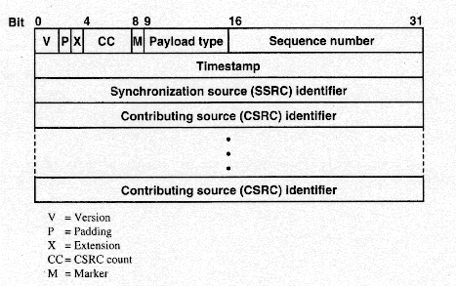
RTP Header

Slide 14
RTCP
ID of sender
Provides various reports for use in:
  QoS and congestion control
    so an app can change resolution or compression strategies
  Session size and scaling
    conferencing

Slide 15
Mixers and Translators
Mixer
  Could receive and combine various sources in an effort to reduce bandwidth
Translator
  Keeps incoming sources separate
  To transform to a lower quality format to broadcast on lower-speed networks
  To send through firewalls

Slide 16
Compression
Can use various types
  JPEG
  MPEG
  H.261
Provided by application
Negotiated using RTCP

Slide 17
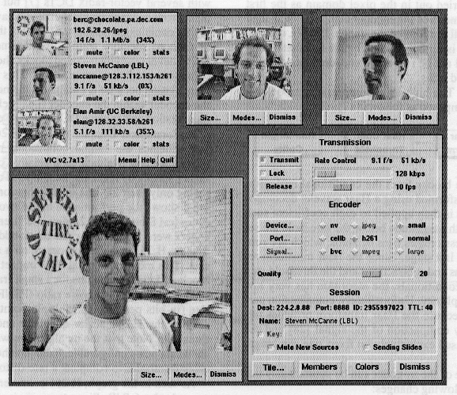
Vic: a Video Conferencing Tool

Slide 18
Vic (2)
Based on MBone
Motivation:
  A composable tool
Helped drive the evolution of RTP
  JPEG payload format
  H.261 payload format
  Overall specifications

Slide 19
Vic (3)
User Interface
Proprietary compression: “Intra-H261”
Security provided by DES
  Confidentiality only
    no key distribution
  Data Encryption Standard: Remember?
  Much cheaper than compression!

Slide 20
Summary
Multimedia applications have much different needs than http or ftp!
RTP meets those needs:
    Minimized jitter
    Synchronized sources
    Dynamic, payload-specific frame length
    Adaptation in the face of congestion
    Interoperability
    Effective use of bandwidth
    Support for video-conferencing (multicast, IDs)

